Slide 1
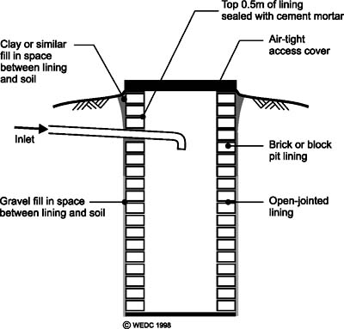
LEACH
Bio Leach to be added in Leach Pit
Toilets .
Initial dosage : 1 litres
Regular : 250 ml / month
Advantages :
No foul odour from leach pit
Faecal matter is decomposed
Minimum accumulation of sludge
No manual scavenging is required
Single Pit is more than sufficient
No blockage or Choking of toilets
Bio Leach

