Slide 1
Water and Sanitation
An Innovative New Approach for Ganga Cleaning

Slide 2
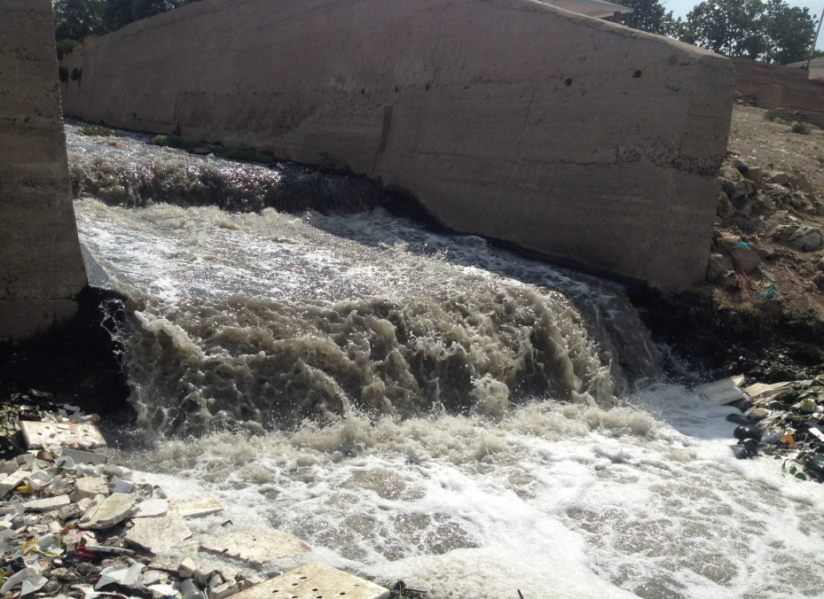
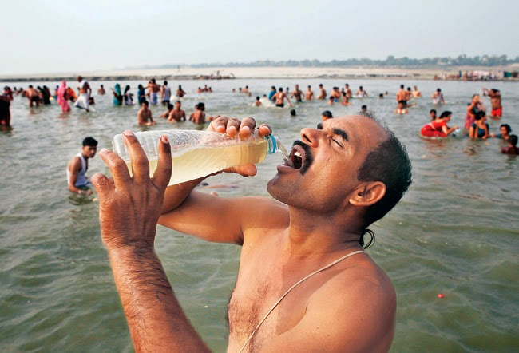
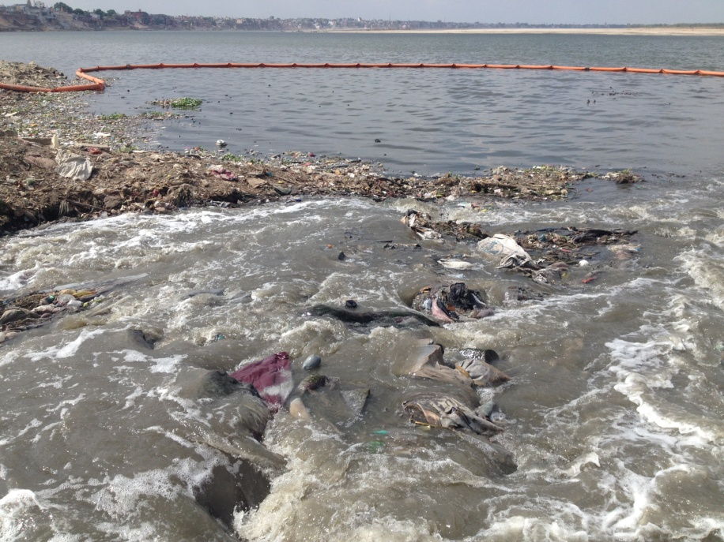
Water – Source and Pollution
Rivers are the major source of fresh water for drinking and agriculture.
The same rivers are used as the dumping drains for sewage and Effluents.
This is the sight of 6MLD sewage confluence by Nagwa drain in Ganga in upstream of Varanasi city. Pilgrims bathing and drinking in the same water.

Slide 3
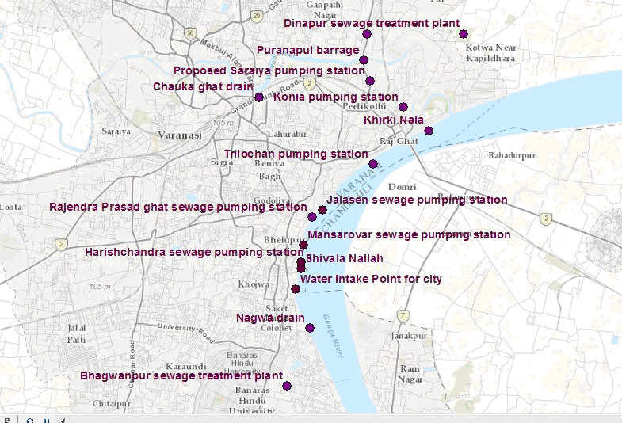
60 MLD Sewage dumped upstream Varanasi city by Nagwa (Assi) Drain

Slide 4
Ganga River Water Quality in Varanasi
LOCATIONS | TDS (mg/L) | DO (mg/L) | BOD (mg/L) | FCC/100 ml
Nagwa | 520 | 2.8 | 42 .0 | 3600000
Tulsi Ghat | 330 | 6.4 | 7.4 | 90000
Shivala Ghat | 300 | 6.6 | 7.2 | 86000
Kshemeshwar Ghat | 300 | 6.6 | 5.2 | 81000
R.P. Ghat | 295 | 6.8 | 5.6 | 43000
Panch Ganga Ghat | 280 | 6.8 | 4.0 | 23000
Trilochan Ghat | 310 | 6.4 | 6.6 | 110000
Varuna Confluence | 640 | 0 | 54.0 | 62000000
Safe Bath
Limit of FCC – 500 per 100 ml

Slide 5
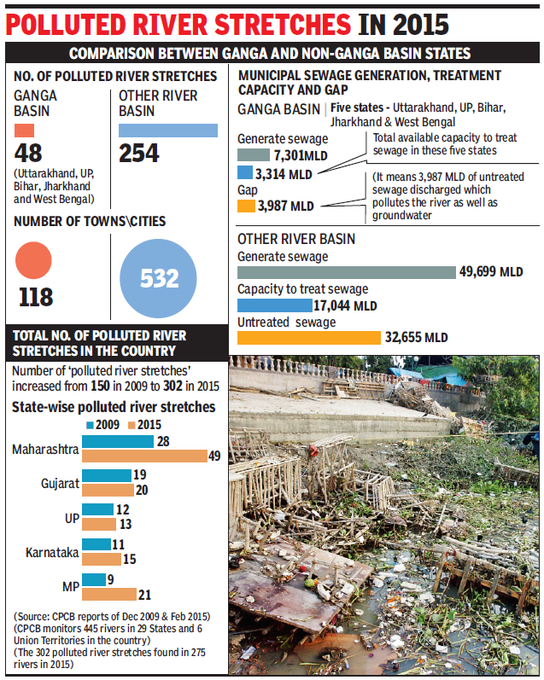
River Pollution in India

Slide 6
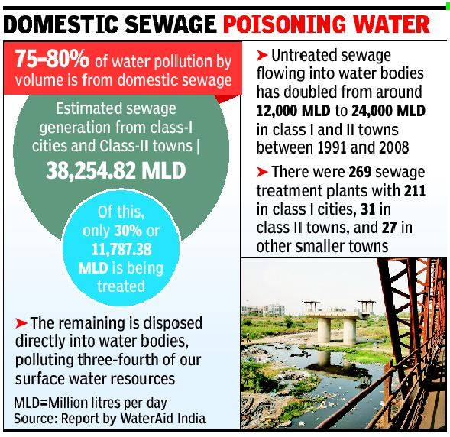
River Pollution in India

Slide 7
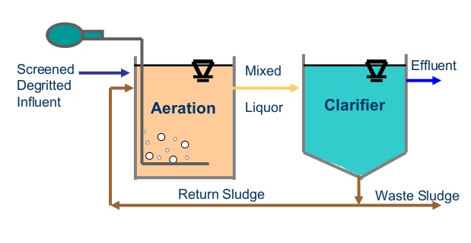
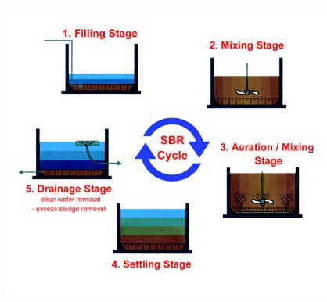
Existing Treatment Technologies
Most of the Sewage treatment plants employ the Biological process based technologies.
Commonly used technologies:
ACTIVATED SLUDGE PROCESS (ASP)
SEQUENTIAL BATCH REACTOR (SBR)

Slide 8
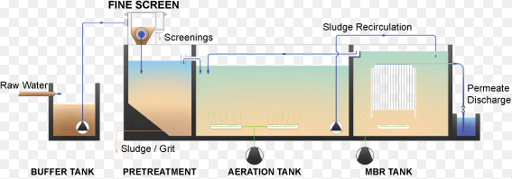
Existing Treatment Technologies
MOVING BED - BIO REACTOR (MBBR)
MEMBRANE BED-BIO REACTOR (MBR)

Slide 9
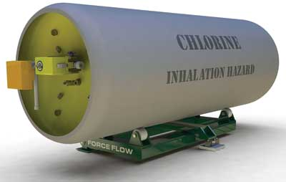
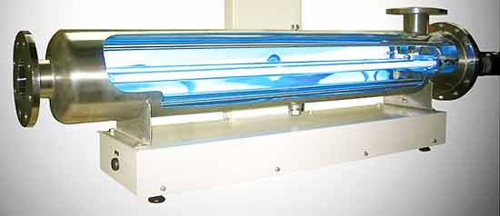
Post Treatment & Disinfection
Use of chlorine for disinfection is hazardous
UV disinfection process is unreliable

Slide 10
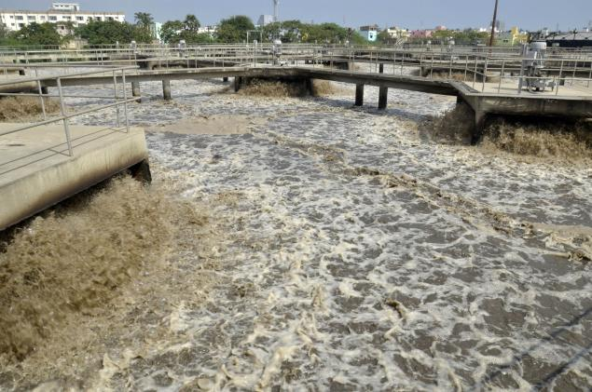
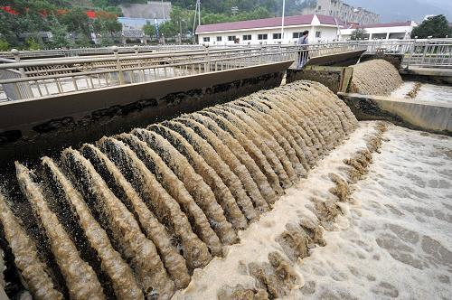
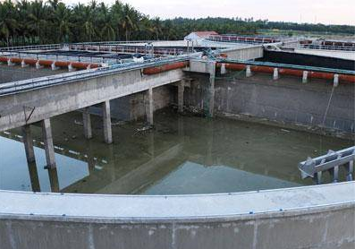
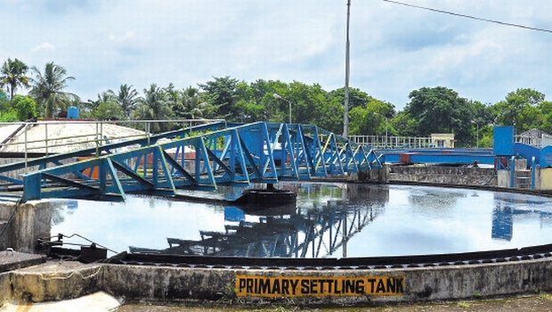
Problems Faced In Biological Based STPs
Problems Faced In Biological Based STPs
Large Foot Print, Tank Capacities, Land Requirement, Resistance to Land Acquisition & Longer Project Execution Time.

Slide 11
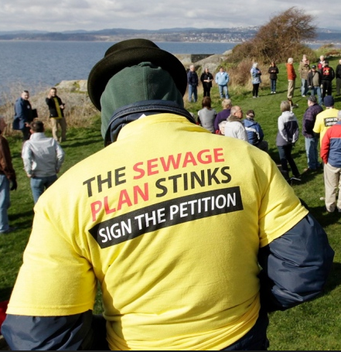
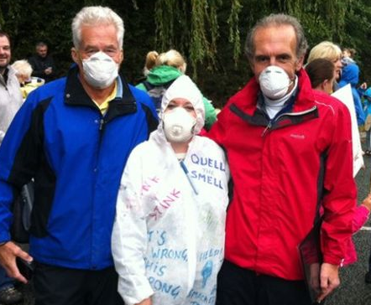
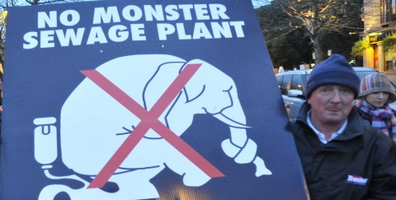
Problems Faced In Biological Based STPs
Problems faced in Biological Based STPs
Bad odour makes general public wary and protest

Slide 12
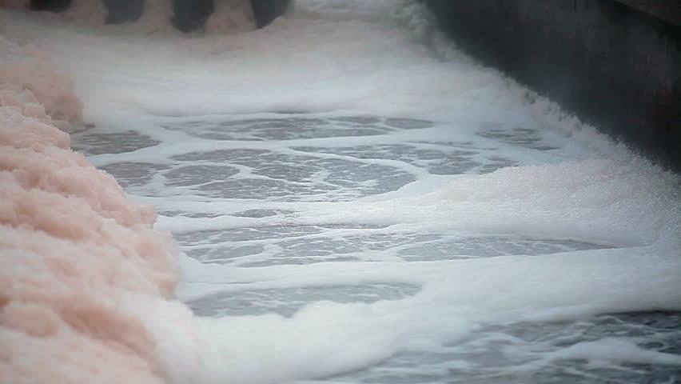
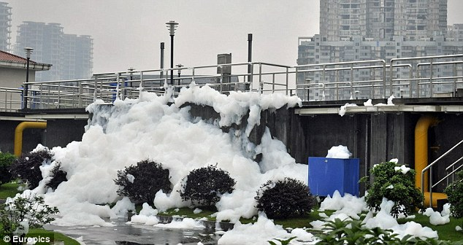
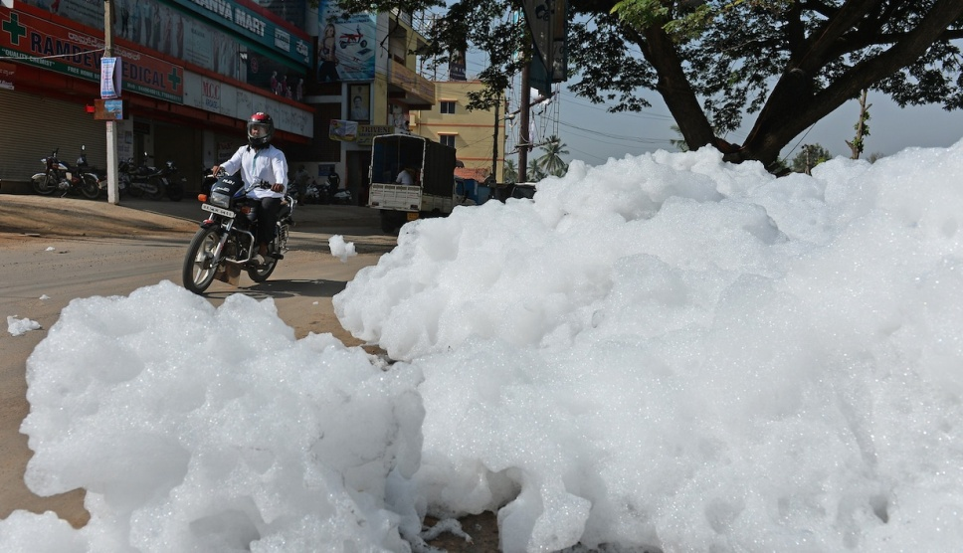
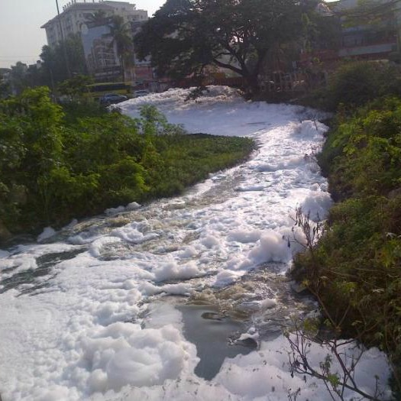
Problems Faced In Biological Based STPs
Problems faced in Biological Based STPs
Surfactants which are caused by soaps, detergents, floor cleaning products are not treatable with biological process. Huge foaming caused in down streams due to surfactants.

Slide 13
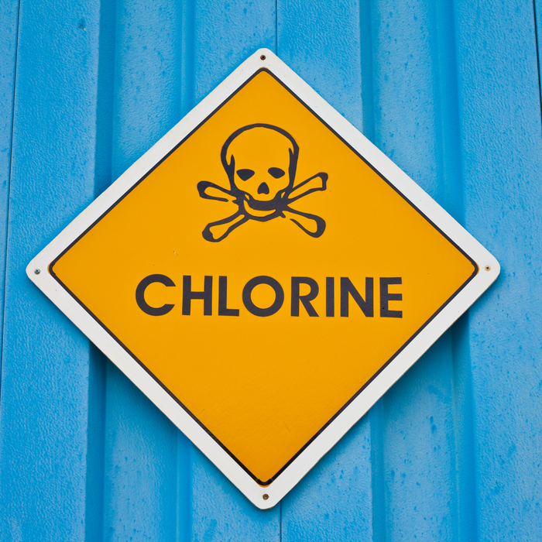
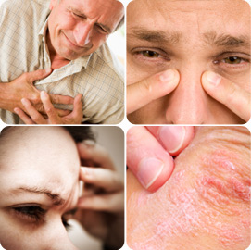
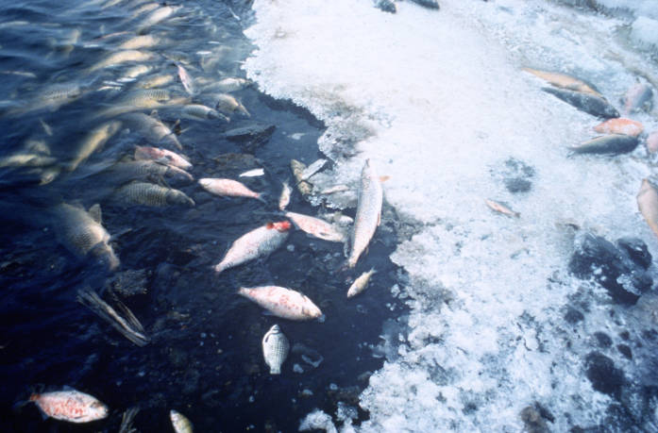
Problems Faced In Biological Based STPs
Problems Faced in Biological Based STPs
Chlorination is unsafe. Harmful to humans, animals, aqua life and environment. Residual chlorine kills any living organisms in the downstream rivers.

Slide 14
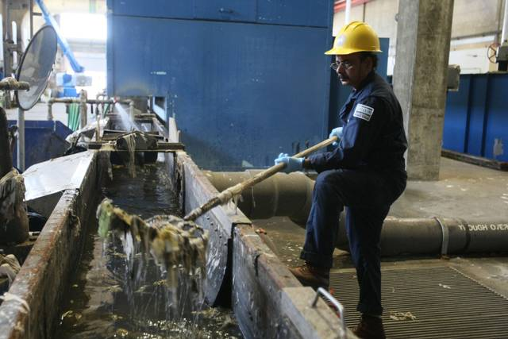
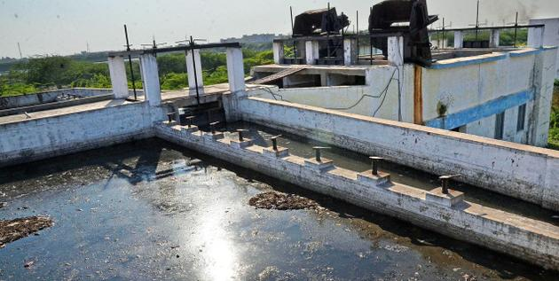
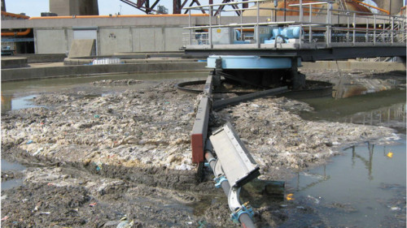
Problems Faced In Biological Based STPs
Problems faced in Biological Based STPs
Shock loads will make the biological process to collapse and the plant will not perform.

Slide 15
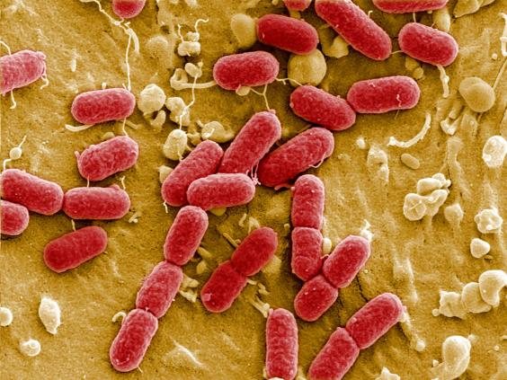
Problems Faced In Biological Based STPs
Problems Faced In Biological Based STPs
ARB- Antibiotic Resistant Bacteria is Generated in STPs
Scientists discovered the drug-resistant bacteria in sediment samples taken downstream of the sewerage plant on the River Sowe near Coventryin, UK. The microbes contained mutated genes that confer resistance to the latest generation of antibiotics.
The researchers believe the discovery shows how antibiotic resistance has become widespread in the environment, with sewage-treatment plants now acting as giant “mixing vessels” where antibiotic resistance can spread between different microbes.

Slide 16
Pollution – Causes
Untreated sewage discharge
Industrial Effluents discharge
Population growth & urbanization
Sewage treatment infrastructure inadequate
Deficiencies in sewage treatment technologies used
Indiscriminate pumping of ground water without rejuvenation

Slide 17
Pollution – Effects
Waterborne diseases
Causes Cancer
Stress on Infrastructure
Resources running out
Bad Odour
Root cause for Super Bugs
Deterioration of soil fertility
Salinization of ground water
Arsenic Poisoning

Slide 18
Water – As nature meant it to be:
Virus / bacteria free
Color / odour less
Free from heavy metals /Arsenic
Free from suspended solids

Slide 19
Water Treatment– The way it should to be:
Less foot print and land requirement
Low carbon coot print
Short Installation and commissioning time
No Odor issues
Solar powered
Installable on the top of sewage canals
Chemical free disinfection method
Clean, safe treated water ready to use for irrigation & industries
Simple, easy to operate and maintain
Decentralized smaller treatment plants

Slide 20
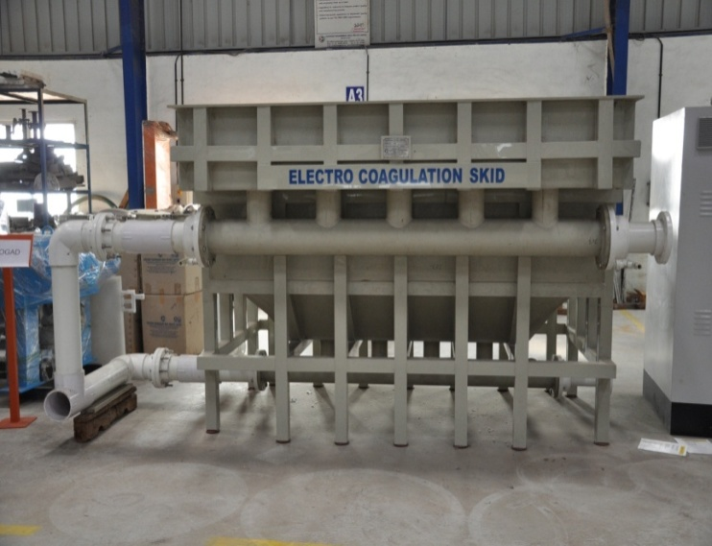
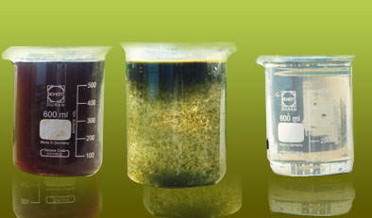
Presenting Alternative Technologies: Plasma Electro-Oxidation
Plasma Electro-oxidation is a unique and latest technology successfully implemented in various countries. Advantages are:
No addition of chemicals for coagulant
Very low operating cost
Less requirement of space and civil work
Very less solid waste (sludge) generation
Colour Removal up to 95%
BOD removal > 60%
COD removal > 70%
Kills Bacteria and califormes
Removal of Heavy metals
Simple, easy to operate and maintain

Slide 21
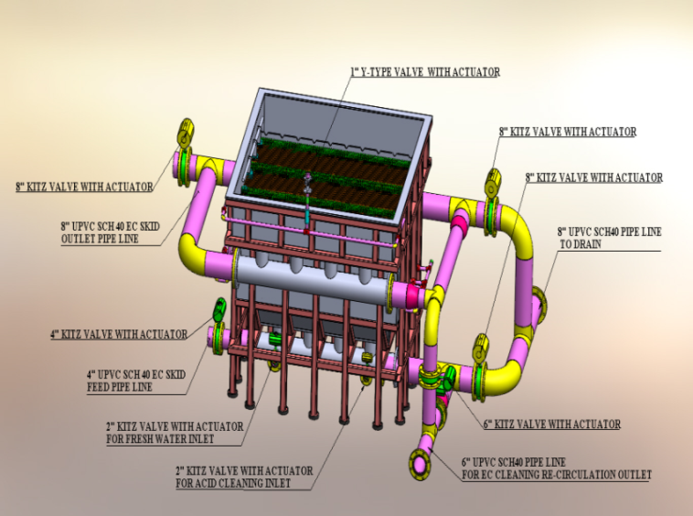
Advantages of the proposed treatment scheme:
Remove BOD, TSS, FOG, etc., from wastewater before disposal to river thus avoiding the river pollution.
Removal of color up to 95%
Low operating cost
Very small Footprint
Low emission of CO2 and Methane.
Can handle any Shock loads, no failures due to shock loads
The process itself is disinfecting the bacteria and thus reduces the Coliform and E-Coli extensively.
The project can be installed in a small area near to the Naala or even on top of the Naala itself by making a platform

Slide 22
Plasma Electro-Oxidation
It is one of most powerful commercially available oxidants & disinfectant for water treatment. Compared to Chlorine, the most common water disinfection chemical, it is more than 50% stronger oxidizer and acts over 3000 times faster. In addition to its capabilities, it is an environmentally friendly method of treatment without creating harmful by products or significant residues.

Slide 23
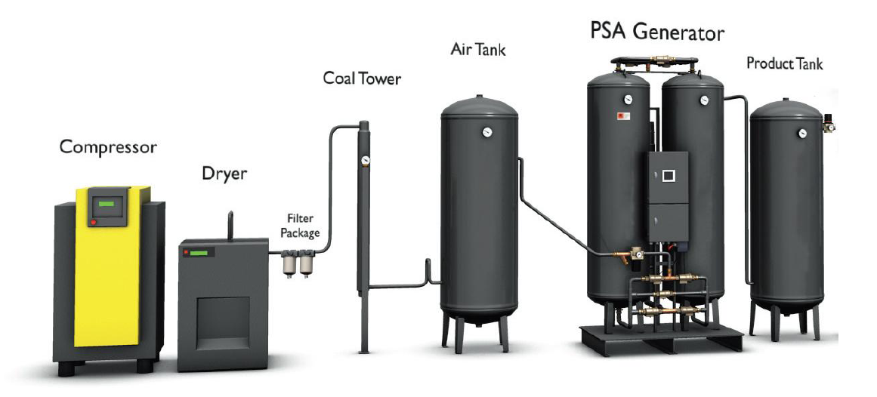
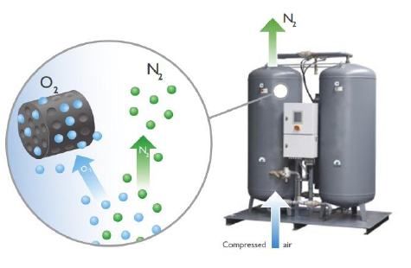
Plasma Electro-Oxidation
Features:
100% Chemical free
No Eye & Skin Irritation
Strongest in disinfection
Removes odors, colors & Toxins
Oxides metal and organic matter
No harmful by products
No negative impact
Huge electricity savings
Simple, easy to operate and maintain

Slide 24
Plasma Electro-Oxidation
Distinct Advantages:
Low Capital cost
Less foot print and land requirement
Low Carbon Foot print
No Odor Problems
Solar powered plants could be made
Plants can be installed on the top of sewage canals
Disinfection in ECO- friendly way, No chlorine is used
Crystal Clear and safe treated water which can be used for irrigation& industries
Simple, easy to operate and maintain
Decentralized smaller STPs are ideal alternative to big Biological STPs

Slide 25
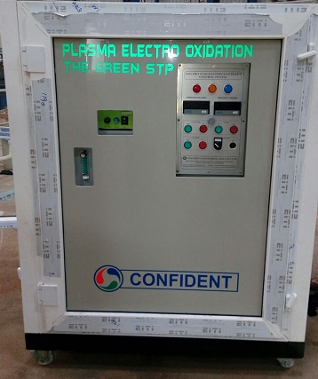
Plasma Electro-Oxidation
Pilot Plant:

Slide 26
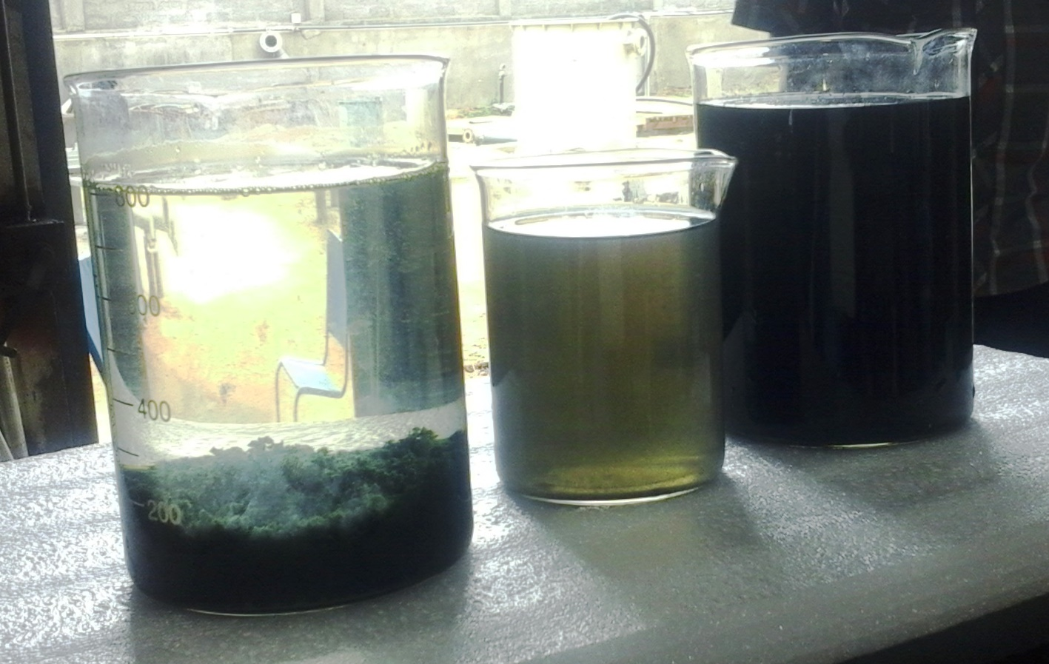
Plasma Electro-Oxidation
Pilot Trials:

Slide 27
Plasma Electro-Oxidation
Pilot Trials Parameters:
PARAMETER | RAW SEWAGE | TREATED WATER | PERCENTAGE REDUCTION
COD | 450 mg/L | 30mg/L | 93.3%
BOD | 280 mg/L | Non Detectible | 99%
TSS | 120 mg/L | 10 mg/L | 91%
Colour | 1700 Pt.Co | 60 Pt.Co | 96.5%
Fecal Coliform | 3.8 x10⁵ MPN / 100ml | <100 MPN/100ml | 99.99%

Slide 28
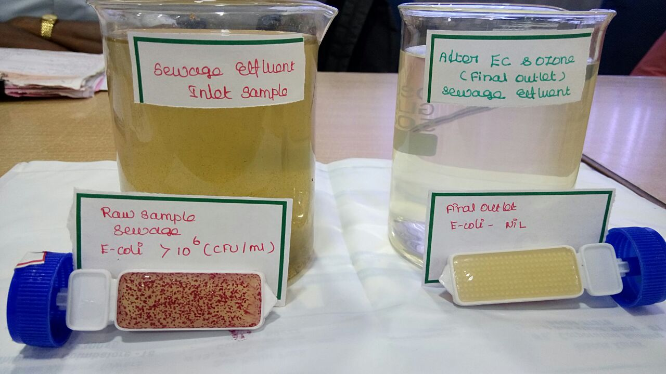
Plasma Electro-Oxidation
Results in 60 Seconds treatment:

Slide 29
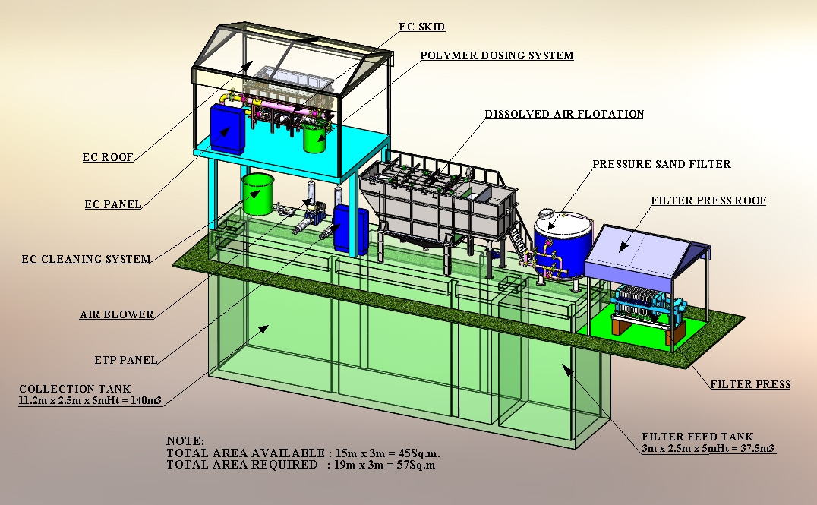
Plasma Electro-Oxidation
Compact STP Layout:

Slide 30
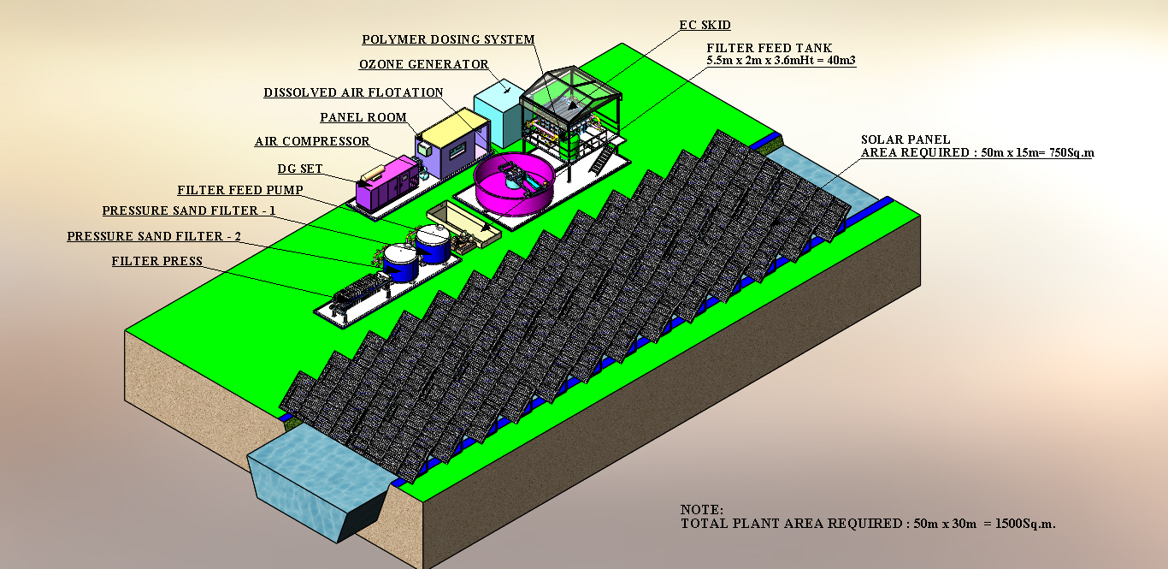
Plasma Electro-Oxidation
Ganga 3MLD STP based on Plasma Electro-Oxidation Technology:

Slide 31
Plasma Electro-Oxidation
Decentralized STPs:
Confident Proposes to build, Install and operate a Pilot STP of 2-3 MLD Capacity in Ganga river Basin.
The Plant will be based on Plasma Electro-Oxidation technology and will include DAF Clarifier, Filters, Sludge handling, and Captive Power Generation.
We propose to treat the sewage at generation point itself before reaching the Ganga River.
Solar energy can also be used for the power requirements of the Plant.
Decentralized STP concept have distinct advantages over the Centralized plants. The sewage can be treated at the source, the treated water can be used for different applications including Parks and Industries in the locality.
The Project can be executed in very short time (4 Months). The Space required is less than 200 Sq. Meters.

